Slide 1
Graph Representations
Adjacency Matrix & Adjacency List
Editable Java code + classroom-ready visualizations
1
2
Unweighted
Weighted
Directed
Undirected
5
0
4
2
Lesson focus
1. Store graph connections in a 2D matrix
2. Store graph connections in linked adjacency lists
3. Change only the edge insertion rule for each graph type
1
3
3
6
4

Slide 2
Graph Types in This Lesson
The same graph idea changes based on direction and weight.
Unweighted + Undirected
Unweighted + Directed
Store 1 in both directions: A[u][v] = 1 and A[v][u] = 1
Store 1 only from source to destination: A[u][v] = 1
Weighted + Directed
Weighted + Undirected
Store the edge weight only in A[u][v]
Store the edge weight in both A[u][v] and A[v][u]
Key idea
Only the addEdges() logic changes; printing and neighbor scanning are almost the same.

Slide 3
Adjacency Matrix: Core Idea
A V x V matrix stores whether an edge exists between vertices.
0
1
2
3
4
Undirected
Directed
0
0
1
0
1
0
A[u][v] and A[v][u]
are both updated.
Only A[u][v] is updated.
A[v][u] may remain 0.
1
1
0
1
1
1
2
0
1
0
0
1
3
1
1
0
0
1
Unweighted
Weighted
Use 1 to show a connection.
Use the edge weight instead of 1.
4
0
1
1
1
0
Matrix rule
Row 1, column 4 = 1 means vertex 1 is connected to vertex 4.
Row = source vertex
Column = destination / neighbor
0 = no edge

Slide 4
Adjacency Matrix: Undirected Unweighted Graph
Example from the driver: edges are added in both directions.
Graph
Adjacency Matrix
0
1
2
3
4
1
0
0
1
0
1
0
1
1
0
1
1
1
0
2
2
0
1
0
0
1
3
1
1
0
0
1
4
0
1
1
1
0
3
4
Observation
The matrix is symmetric.
For every 1 in A[u][v], there is a matching 1 in A[v][u].

Slide 5
Editable Java: Undirected Unweighted Matrix
Core class code is editable.
public class GraphUndirectedUnweightedMatrix {
private int numVertices;
private int[][] adjMatrix;
public GraphUndirectedUnweightedMatrix(int numVertices) {
this.numVertices = numVertices;
adjMatrix = new int[numVertices][numVertices];
}
public void addEdges(int[][] edges) {
for (int i = 0; i < edges.length; i++) {
int source = edges[i][0];
int destination = edges[i][1];
adjMatrix[source][destination] = 1;
adjMatrix[destination][source] = 1;
}
}
public void printMatrix() {
System.out.println("Adjacency Matrix:");
for (int i = 0; i < numVertices; i++) {
for (int j = 0; j < numVertices; j++)
System.out.print(adjMatrix[i][j] + " ");
System.out.println();
}
}
public void findNeighbors(int vertex) {
System.out.print("Neighbors of vertex " + vertex + ": ");
for (int i = 0; i < numVertices; i++)
if (adjMatrix[vertex][i] == 1) System.out.print(i + " ");
System.out.println();
}
}
Insertion rule
Because the graph is undirected, one edge creates two matrix updates.
int[][] edges = {
{0,1}, {0,3},
{1,3}, {1,2}, {1,4},
{2,4},
{3,4}
};
GraphUndirectedUnweightedMatrix graph =
new GraphUndirectedUnweightedMatrix(5);
graph.addEdges(edges);
Result
The final matrix has 1s in symmetric positions.

Slide 6
Adjacency Matrix: Directed Unweighted Graph
Some pairs are bidirectional, while some edges are one-way.
Graph
Adjacency Matrix
0
1
2
3
4
1
0
0
1
1
0
0
1
1
0
1
1
0
0
2
2
0
1
0
0
0
3
0
0
1
0
1
4
1
0
1
0
0
3
4
Observation
The matrix is not symmetric.
Example: A[4][0] = 1 but A[0][4] = 0.

Slide 7
Editable Java: Directed Unweighted Matrix
Only source -> destination is stored.
public class GraphDirectedUnweightedMatrix {
private int numVertices;
private int[][] adjMatrix;
public GraphDirectedUnweightedMatrix(int numVertices) {
this.numVertices = numVertices;
adjMatrix = new int[numVertices][numVertices];
}
public void addEdges(int[][] edges) {
for (int i = 0; i < edges.length; i++) {
int source = edges[i][0];
int destination = edges[i][1];
adjMatrix[source][destination] = 1;
}
}
public void printMatrix() {
System.out.println("Adjacency Matrix:");
for (int i = 0; i < numVertices; i++) {
for (int j = 0; j < numVertices; j++)
System.out.print(adjMatrix[i][j] + " ");
System.out.println();
}
}
public void findNeighbors(int vertex) {
System.out.print("Neighbors of vertex " + vertex + ": ");
for (int i = 0; i < numVertices; i++)
if (adjMatrix[vertex][i] == 1) System.out.print(i + " ");
System.out.println();
}
}
Insertion rule
Do not automatically add the reverse edge.
int[][] edges = {
{0,1}, {0,2},
{1,0}, {1,2}, {1,3},
{2,1},
{3,2}, {3,4},
{4,0}, {4,2}
};
Neighbor meaning
Neighbors of u = vertices reachable from row u.

Slide 8
Adjacency Matrix: Directed Weighted Graph
Nonzero values store edge weights, not just 1.
Graph
Adjacency Matrix
0
1
2
3
4
4
0
0
2
3
0
0
5
1
1
0
0
0
4
5
2
0
4
2
0
0
0
6
0
3
3
3
0
0
0
0
0
6
2
4
0
0
0
0
0
Observation
A[1][3] = 4 means there is a directed edge 1 -> 3 with weight 4.

Slide 9
Editable Java: Directed Weighted Matrix
The edge format is {source, destination, weight}.
public class GraphDirectedWeightedMatrix {
private int numVertices;
private int[][] adjMatrix;
public GraphDirectedWeightedMatrix(int numVertices) {
this.numVertices = numVertices;
adjMatrix = new int[numVertices][numVertices];
}
public void addEdges(int[][] edges) {
for (int i = 0; i < edges.length; i++) {
int source = edges[i][0];
int destination = edges[i][1];
int weight = edges[i][2];
adjMatrix[source][destination] = weight;
}
}
public void printMatrix() {
System.out.println("Adjacency Matrix:");
for (int i = 0; i < numVertices; i++) {
for (int j = 0; j < numVertices; j++)
System.out.print(adjMatrix[i][j] + " ");
System.out.println();
}
}
public void findNeighbors(int vertex) {
System.out.print("Neighbors of vertex " + vertex + ": ");
for (int i = 0; i < numVertices; i++)
if (adjMatrix[vertex][i] != 0) System.out.print(i + " ");
System.out.println();
}
}
Insertion rule
Store weight only in A[source][destination].
int[][] edges = {
{0,1,2},
{0,2,3},
{1,3,4},
{1,4,5},
{2,3,6}
};
Neighbor check
Use != 0 because weights may be any nonzero number.

Slide 10
Adjacency Matrix: Undirected Weighted Graph
The same weight is stored in both symmetric positions.
Graph
Adjacency Matrix
0
1
2
3
4
4
0
0
2
3
0
0
5
1
1
2
0
0
4
5
2
0
4
2
3
0
0
6
0
3
3
3
0
4
6
0
0
6
2
4
0
5
0
0
0
Observation
A[2][3] = 6 and A[3][2] = 6. The matrix is symmetric.

Slide 11
Editable Java: Undirected Weighted Matrix
One weighted edge updates two cells.
public class GraphUndirectedWeightedMatrix {
private int numVertices;
private int[][] adjMatrix;
public GraphUndirectedWeightedMatrix(int numVertices) {
this.numVertices = numVertices;
adjMatrix = new int[numVertices][numVertices];
}
public void addEdges(int[][] edges) {
for (int i = 0; i < edges.length; i++) {
int source = edges[i][0];
int destination = edges[i][1];
int weight = edges[i][2];
adjMatrix[source][destination] = weight;
adjMatrix[destination][source] = weight;
}
}
public void printMatrix() {
System.out.println("Adjacency Matrix:");
for (int i = 0; i < numVertices; i++) {
for (int j = 0; j < numVertices; j++)
System.out.print(adjMatrix[i][j] + " ");
System.out.println();
}
}
public void findNeighbors(int vertex) {
System.out.print("Neighbors of vertex " + vertex + ": ");
for (int i = 0; i < numVertices; i++)
if (adjMatrix[vertex][i] != 0) System.out.print(i + " ");
System.out.println();
}
}
Insertion rule
Set both A[source][destination] and A[destination][source] to weight.
int[][] edges = {
{0,1,2},
{0,2,3},
{1,3,4},
{1,4,5},
{2,3,6}
};
Result
A symmetric weighted matrix.

Slide 12
Adjacency List: Core Idea
Each vertex stores a list of its neighbors instead of a full V x V table.
0
3
1
Why adjacency list?
It stores only existing edges, so it is usually more space-efficient for sparse graphs.
1
4
2
3
0
2
4
1
Neighbor search
3
4
1
0
To find neighbors of vertex u, traverse only list[u].
4
3
2
1
Implementation style
In Java, each row can be a linked list of Node objects.

Slide 13
Adjacency List: Undirected Unweighted Graph
For an undirected edge, add each vertex to the other vertex's list.
Graph
Adjacency List
1
0
3
1
1
4
2
3
0
0
2
2
4
1
3
4
1
0
3
4
3
2
1
4
Rule
For edge (u, v): insert v into list[u] and insert u into list[v].

Slide 14
Editable Java: Undirected Unweighted Adjacency List (1/3)
Edge node, graph setup, and insertion methods.
Edge class + constructor
addEdges() + addEdge()
class Edge {
int destination;
Edge next;
public Edge(int destination) {
this.destination = destination;
this.next = null;
}
}
public class GraphUndirectedUnweightedAdjacencyList {
private int numVertices; // Total number of vertices
private Edge[] adjList; // Array of linked lists (Adjacency List)
// Constructor: initialize graph
public GraphUndirectedUnweightedAdjacencyList(int numVertices) {
this.numVertices = numVertices;
// Create an array of size = numVertices
// Each index will store the head of a linked list
adjList = new Edge[numVertices]; // Initially all values are null
}
// Add multiple edges to the graph
public void addEdges(int[][] edges) {
// edges format: { {source, destination}, ... }
for (int i = 0; i < edges.length; i++) {
int source = edges[i][0]; // Starting vertex
int destination = edges[i][1]; // Ending vertex
// For UNDIRECTED graph:
// Add edge in BOTH directions
addEdge(source, destination); // source → destination
addEdge(destination, source); // destination → source
}
}
// Helper method to add a single edge
private void addEdge(int source, int destination) {
// Step 1: Create a new edge node
Edge newEdge = new Edge(destination);
// Step 2: Insert at the beginning (prepend)
// This ensures O(1) insertion time
newEdge.next = adjList[source];
// Step 3: Update head of the list
adjList[source] = newEdge;
}
For an undirected edge, add each vertex to the other vertex's list.

Slide 15
Editable Java: Undirected Unweighted Adjacency List (2/3)
Methods for printing the list and finding neighbors.
printList()
findNeighbors()
// Print the full adjacency list
public void printList() {
System.out.println("Adjacency List:");
// Traverse each vertex
for (int i = 0; i < numVertices; i++) {
System.out.print(i + ": ");
// Traverse linked list of edges for vertex i
Edge current = adjList[i];
while (current != null) {
// Print neighbor (destination only, since unweighted)
System.out.print(current.destination + " ");
current = current.next; // Move to next edge
}
System.out.println();
}
}
// Print neighbors of a given vertex
public void findNeighbors(int vertex) {
System.out.print("\nNeighbors of vertex " + vertex + ": ");
Edge current = adjList[vertex];
// Traverse all neighbors
while (current != null) {
// Print current neighbor
System.out.print(current.destination);
// Add comma if not the last element
if (current.next != null) {
System.out.print(",");
}
current = current.next; // Move to next edge
}
System.out.println();
}
Both methods traverse linked-list nodes using current = current.next.

Slide 16
Editable Java: Undirected Unweighted Adjacency List (3/3)
Driver code and the adjacency list created by prepend insertion.
// Driver code
public static void main(String[] args) {
int numVertices = 5;
int[][] edges = {
{0, 1},
{0, 3},
{1, 3},
{1, 2},
{1, 4},
{2, 4},
{3, 4}
};
GraphUndirectedUnweightedAdjacencyList graph = new GraphUndirectedUnweightedAdjacencyList(numVertices);
System.out.println("Before adding connections:");
graph.printList();
graph.addEdges(edges);
System.out.println("\nAfter adding connections:");
graph.printList();
for (int vertex = 0; vertex < numVertices; vertex++) {
graph.findNeighbors(vertex);
}
}
}
Resulting adjacency list
0: 3 1
1: 4 2 3 0
2: 4 1
3: 4 1 0
4: 3 2 1
Because addEdge() prepends, the newest neighbor appears first.

Slide 17
Adjacency List: Directed Unweighted Graph
Only outgoing neighbors are stored in each source vertex list.
Graph
Adjacency List
0
3
1
1
1
4
2
0
2
2
3
4
1
3
4
2
4
Rule
For edge (u, v): insert only v into list[u].

Slide 18
Editable Java: Directed Unweighted Adjacency List (1/3)
Graph setup and one-way insertion methods. The same Edge class is reused.
Class + constructor
addEdges() + addEdge()
public class GraphDirectedUnweightedAdjacencyList {
private int numVertices; // Total number of vertices in the graph
private Edge[] adjList; // Array of linked lists (Adjacency List)
// Constructor: initialize graph
public GraphDirectedUnweightedAdjacencyList(int numVertices) {
this.numVertices = numVertices;
// Create an array of size = numVertices
// Each index will store the head of a linked list
adjList = new Edge[numVertices]; // Initially all values are null
}
// Add multiple edges to the graph
public void addEdges(int[][] edges) {
// edges format: { {source, destination}, ... }
for (int i = 0; i < edges.length; i++) {
int source = edges[i][0]; // Starting vertex
int destination = edges[i][1]; // Ending vertex
// For DIRECTED graph:
// Add edge in only ONE direction
addEdge(source, destination);
}
}
// Helper method to add a single directed edge
private void addEdge(int source, int destination) {
// Step 1: Create a new edge node
Edge newEdge = new Edge(destination);
// Step 2: Insert at the beginning (prepend)
// This ensures O(1) insertion time
newEdge.next = adjList[source];
// Step 3: Update the head of the list
adjList[source] = newEdge;
}
Directed graph: add only destination to the source vertex's list.

Slide 19
Editable Java: Directed Unweighted Adjacency List (2/3)
Methods for printing outgoing neighbors.
printList()
findNeighbors()
// Print the full adjacency list
public void printList() {
System.out.println("Adjacency List:");
// Traverse each vertex
for (int i = 0; i < numVertices; i++) {
System.out.print(i + ": ");
// Traverse linked list of edges for vertex i
Edge current = adjList[i];
while (current != null) {
// Print only destination (unweighted graph)
System.out.print(current.destination + " ");
current = current.next; // Move to next edge
}
System.out.println();
}
}
// Method to find and print neighbors of a given vertex
public void findNeighbors(int vertex) {
System.out.print("\nNeighbors of vertex " + vertex + ": ");
Edge current = adjList[vertex];
// Traverse all neighbors
while (current != null) {
// Print current neighbor
System.out.print(current.destination);
// Add comma if not the last element
if (current.next != null) {
System.out.print(",");
}
current = current.next; // Move to next edge
}
System.out.println();
}
Only outgoing edges are stored and printed for each source vertex.

Slide 20
Editable Java: Directed Unweighted Adjacency List (3/3)
Driver code and the one-way adjacency lists it creates.
// Driver code
public static void main(String[] args) {
int numVertices = 5;
int[][] edges = {
{0, 1}, {0, 3},
{1, 2}, {1, 4},
{3, 1}, {3, 4},
{4, 2}
};
GraphDirectedUnweightedAdjacencyList graph = new GraphDirectedUnweightedAdjacencyList(numVertices);
System.out.println("Before adding connections:");
graph.printList();
graph.addEdges(edges);
System.out.println("\nAfter adding connections:");
graph.printList();
for (int vertex = 0; vertex < numVertices; vertex++) {
graph.findNeighbors(vertex);
}
}
}
Resulting adjacency list
0: 3 1
1: 4 2
2:
3: 4 1
4: 2
Only outgoing edges appear in a vertex's list.

Slide 21
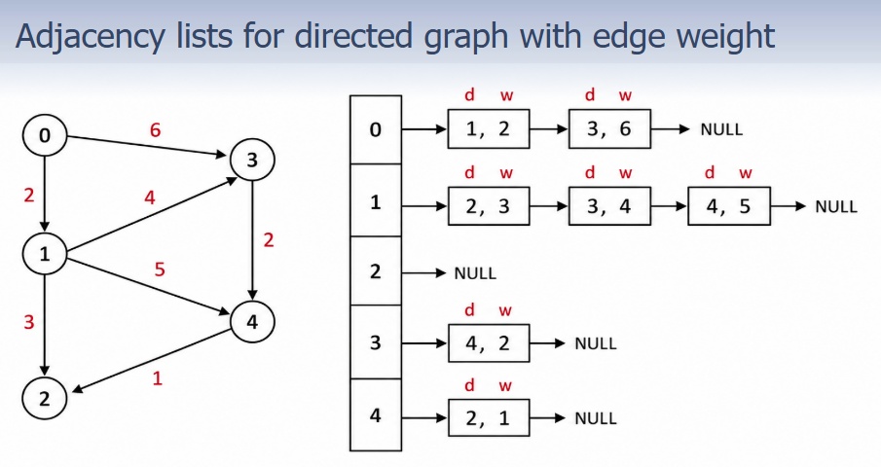
Adjacency List: Directed Weighted Graph
Sample figure using a light grey theme. The weighted adjacency-list example follows the provided figure.

Slide 22
Editable Java: Directed Weighted Adjacency List (1/3)
WEdge node, graph setup, and insertion methods. Light grey theme applied.
class WEdge {
int destination;
int weight;
WEdge next;
public WEdge(int destination, int weight) {
this.destination = destination;
this.weight = weight;
this.next = nulla;
}
}
public class GraphDirectedWeightedAdjacencyList {
private int numVertices;
private WEdge[] adjList;
public GraphDirectedWeightedAdjacencyList(int numVertices) {
this.numVertices = numVertices;
adjList = new WEdge[numVertices];
}
public void addEdges(int[][] edges) {
for (int i = 0; i < edges.length; i++) {
int source = edges[i][0];
int destination = edges[i][1];
int weight = edges[i][2];
addEdge(source, destination, weight);
}
}
public void addEdge(int source, int destination, int weight) {
WEdge newEdge = new WEdge(destination, weight);
newEdge.next = adjList[source];
adjList[source] = newEdge;
}
}

Slide 23
Editable Java: Directed Weighted Adjacency List (2/3)
Methods for printing the weighted adjacency list and neighbors.
public void printList() {
System.out.println("Adjacency List with Weights:");
for (int i = 0; i < numVertices; i++) {
System.out.print(i + ": ");
WEdge current = adjList[i];
while (current != null) {
System.out.print("(" + current.destination + ", " + current.weight + ") ");
current = current.next;
}
System.out.println();
}
}
public void findNeighbors(int vertex) {
System.out.print("\nNeighbors of vertex " + vertex + ": ");
WEdge current = adjList[vertex];
while (current != null) {
System.out.print("(" + current.destination + ", " + current.weight + ")");
if (current.next != null) {
System.out.print(",");
}
current = current.next;
}
System.out.println();
}

Slide 24
Editable Java: Directed Weighted Adjacency List (3/3)
Driver code and the resulting output from prepend insertion.
// Driver code
public static void main(String[] args) {
int numVertices = 5;
int[][] edges = {
{0, 1, 2}, {0, 3, 6},
{1, 2, 3}, {1, 4, 5},
{3, 1, 4}, {3, 4, 2},
{4, 2, 1}
};
GraphDirectedWeightedAdjacencyList graph =
new GraphDirectedWeightedAdjacencyList(numVertices);
System.out.println("Before adding connections:");
graph.printList();
graph.addEdges(edges);
System.out.println("\nAfter adding connections:");
graph.printList();
for (int vertex = 0; vertex < numVertices; vertex++) {
graph.findNeighbors(vertex);
}
}
Resulting adjacency list
(prepend insertion)
0: (3, 6) (1, 2)
1: (4, 5) (2, 3)
2:
3: (4, 2) (1, 4)
4: (2, 1)
Neighbors of vertex 0: (3, 6),(1, 2)
Neighbors of vertex 1: (4, 5),(2, 3)
Neighbors of vertex 2:
Neighbors of vertex 3: (4, 2),(1, 4)
Neighbors of vertex 4: (2, 1)

Slide 25
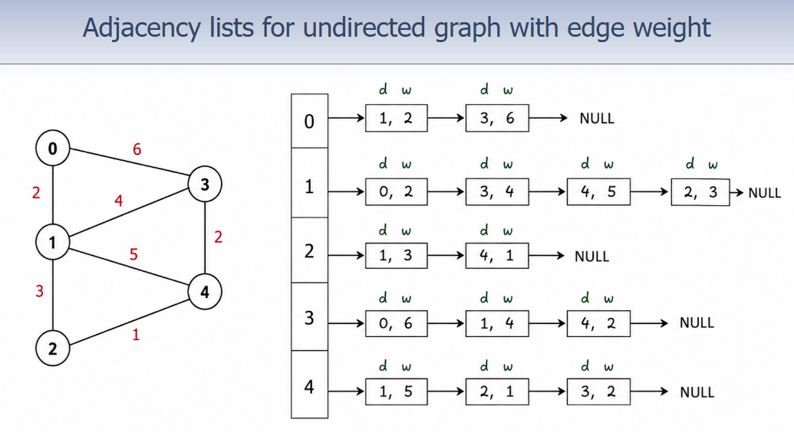
Adjacency List: Undirected Weighted Graph
Sample figure using a light grey theme. The weighted adjacency-list example follows the provided figure.

Slide 26
Editable Java: Undirected Weighted Adjacency List (1/3)
Graph setup and insertion in both directions. Light grey theme applied.
public class GraphUndirectedWeightedAdjacencyList {
private int numVertices;
private WEdge[] adjList;
public GraphUndirectedWeightedAdjacencyList(int numVertices) {
this.numVertices = numVertices;
adjList = new WEdge[numVertices];
}
public void addEdges(int[][] edges) {
for (int i = 0; i < edges.length; i++) {
int source = edges[i][0];
int destination = edges[i][1];
int weight = edges[i][2];
addEdge(source, destination, weight);
addEdge(destination, source, weight);
}
}
public void addEdge(int source, int destination, int weight) {
WEdge newEdge = new WEdge(destination, weight);
newEdge.next = adjList[source];
adjList[source] = newEdge;
}
}

Slide 27
Editable Java: Undirected Weighted Adjacency List (2/3)
Methods for printing weighted adjacency lists and neighbors.
public void printList() {
System.out.println("Adjacency List with Weights:");
for (int i = 0; i < numVertices; i++) {
System.out.print(i + ": ");
WEdge current = adjList[i];
while (current != null) {
System.out.print("(" + current.destination + ", " + current.weight + ") ");
current = current.next;
}
System.out.println();
}
}
public void findNeighbors(int vertex) {
System.out.print("\nNeighbors of vertex " + vertex + ": ");
WEdge current = adjList[vertex];
while (current != null) {
System.out.print("(" + current.destination + ", " + current.weight + ")");
if (current.next != null) {
System.out.print(",");
}
current = current.next;
}
System.out.println();
}

Slide 28
Editable Java: Undirected Weighted Adjacency List (3/3)
Driver code and the resulting output from prepend insertion.
// Driver
public static void main(String[] args) {
int numVertices = 5;
int[][] edges = {
{0, 1, 2}, {0, 3, 6},
{1, 2, 3}, {1, 4, 5},
{3, 4, 2},
{4, 2, 1}
};
GraphUndirectedWeightedAdjacencyList graph =
new GraphUndirectedWeightedAdjacencyList(numVertices);
System.out.println("Before adding connections:");
graph.printList();
graph.addEdges(edges);
System.out.println("\nAfter adding connections:");
graph.printList();
for (int v = 0; v < numVertices; v++) {
graph.findNeighbors(v);
}
}
Resulting adjacency list
(prepend insertion)
0: (3, 6) (1, 2)
1: (4, 5) (2, 3) (0, 2)
2: (4, 1) (1, 3)
3: (4, 2) (0, 6)
4: (2, 1) (3, 2) (1, 5)
Neighbors of vertex 0: (3, 6),(1, 2)
Neighbors of vertex 1: (4, 5),(2, 3),(0, 2)
Neighbors of vertex 2: (4, 1),(1, 3)
Neighbors of vertex 3: (4, 2),(0, 6)
Neighbors of vertex 4: (2, 1),(3, 2),(1, 5)

Slide 29
Matrix vs List: Quick Comparison
Choose representation based on what your algorithm needs.
Feature
Adjacency Matrix
Adjacency List
Space
V x V cells
V lists + existing edges
Check edge u->v
Fast direct lookup
Search list[u]
Find neighbors of u
Scan row u
Traverse list[u]
Sparse graph
Can waste space
Usually efficient
Classroom takeaway
Matrices are simpler for direct edge lookup; lists are more natural for neighbor traversal.

Slide 30
Practice: Directed or Undirected?
Determine the type by checking matrix symmetry.
Matrix A
Matrix B
0
1
2
3
4
0
1
2
3
4
0
0
1
0
1
0
0
0
1
1
0
0
1
1
0
1
1
0
1
1
0
1
1
0
2
0
1
0
1
1
2
1
1
0
0
1
3
1
1
0
0
1
3
0
1
0
0
1
4
0
0
1
1
0
4
0
0
1
1
0
Solution A
Solution B
Directed. It is not symmetric.
Example: A[2][3] = 1 but A[3][2] = 0.
Undirected. It is symmetric.
For every A[i][j], A[j][i] has the same value.

Slide 31
Summary Cheat Sheet
Use the rule that matches the graph type.
Undirected + Unweighted
Matrix
List
A[u][v] = 1; A[v][u] = 1
insert v in list[u]; insert u in list[v]
Directed + Unweighted
Matrix
List
A[u][v] = 1
insert v in list[u]
Directed + Weighted
Matrix
List
A[u][v] = w
insert v(w) in list[u]
Undirected + Weighted
Matrix
List
A[u][v] = w; A[v][u] = w
insert v(w) in list[u]; insert u(w) in list[v]
Final rule
Direction controls whether the reverse edge is added. Weight controls whether the stored value is 1 or the edge weight.

